Slide 1

Session 1: Electrical

Slide 2
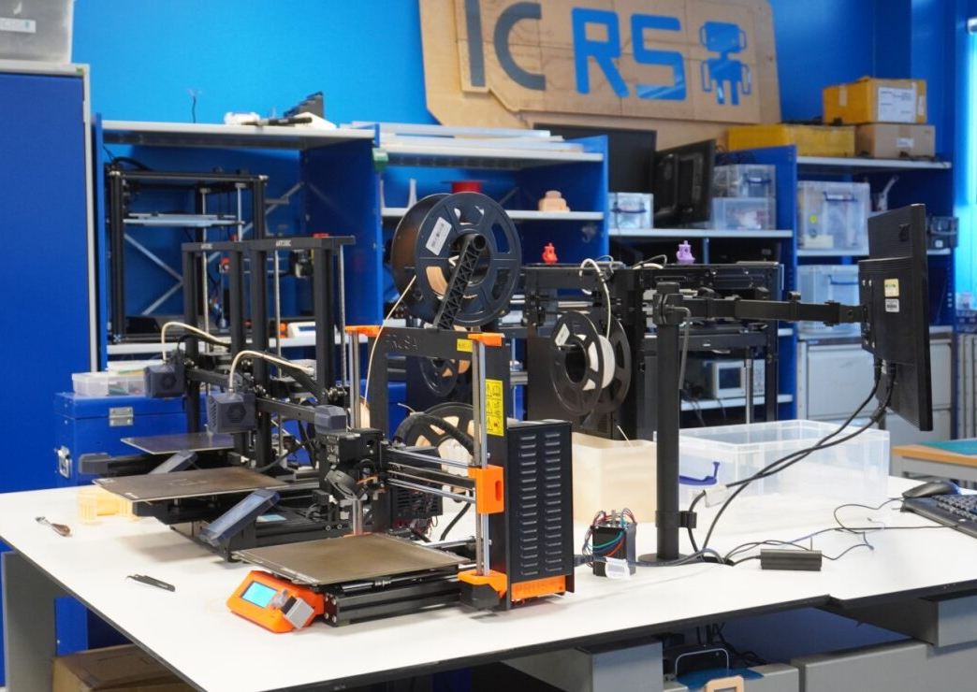
What is ICRS?
Makerspace
Community
Projects

Slide 3
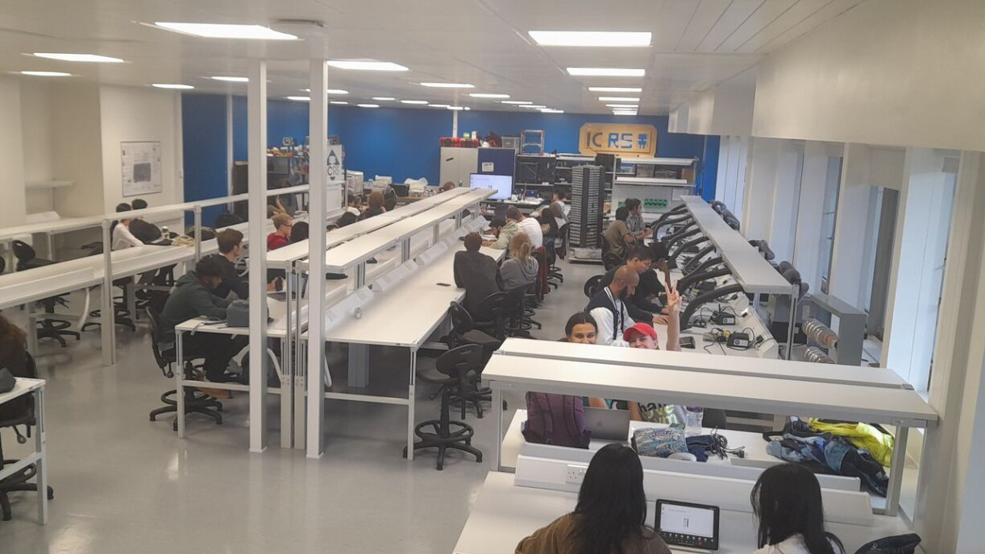
What is Robotics 101?
Introductory course covering the basics for building a simple robot
Electronics, Hardware, Software
Small Competition at the end
Foundation for future projects

Slide 4
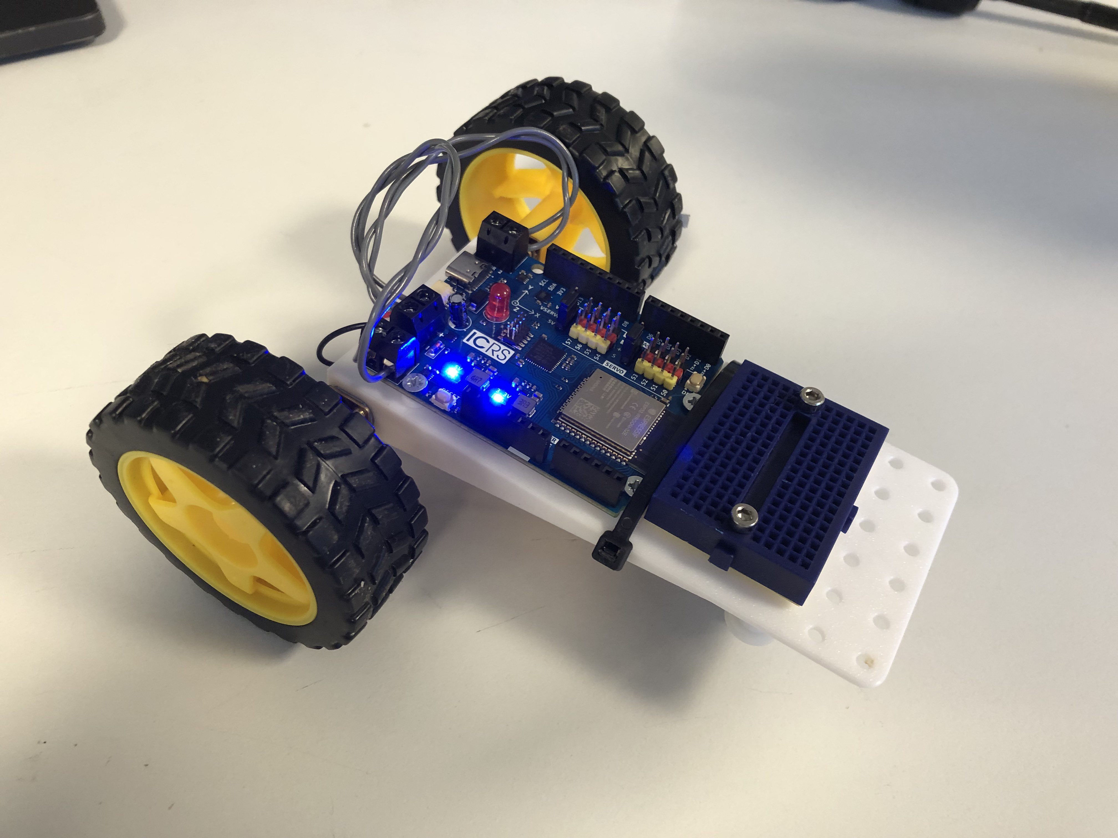
Goals
Build robot
Remote control
Move around
Able to race
Gain basic skills to be able to join society projects and make your own projects come to life.

Slide 5
Session Plan
Session 1: Electrical theory & Soldering
Session 2: Mechanical design & robot assembly
Session 3: Software
Session 4: Testing, debugging and competition.

Slide 6

Session 1: Electrical & Soldering
In a few minutes we will split into groups of 2-4
For the first hour:
One half will do soldering
One half will get a slightly longer introduction & some electronics theory
In the second hour we will switch halves

Slide 7

Make groups!
You can make your own groups, or come to the front and we will put you in groups.
Once you have a group, collect one numbered bag of components per group.
Feel free to come up with a team name and write it on the bag.
Odd numbers will be soldering first in the lab
Even numbers will stay behind

Slide 8
Projects run throughout the year
Eurobot
SSL
Ornithopter
Delivery robot

Slide 9
Finished 101 Robot

Slide 10
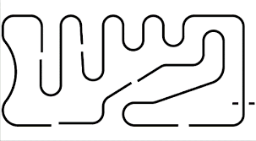
Line following robot
Competition for this will be close to the end of term
Challenge is to build a robot to follow a line down a track

Slide 11
Electronics Basics

Slide 12
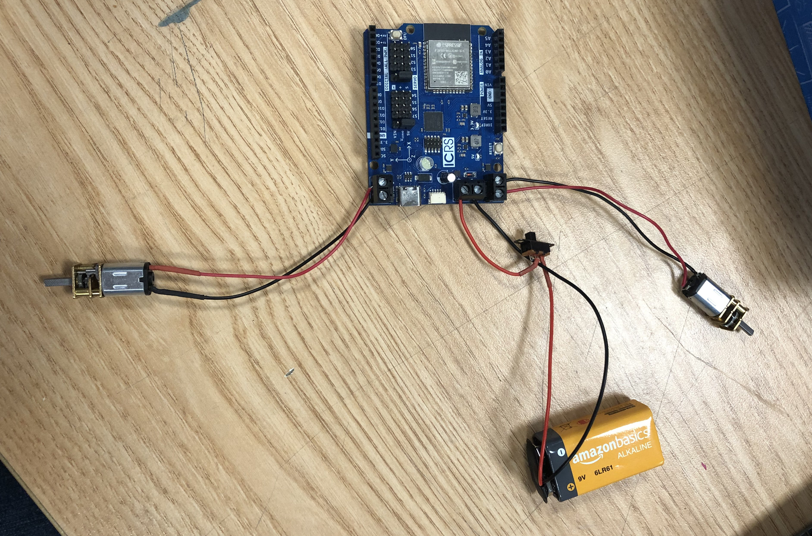
Whole robot electronics image

Slide 13
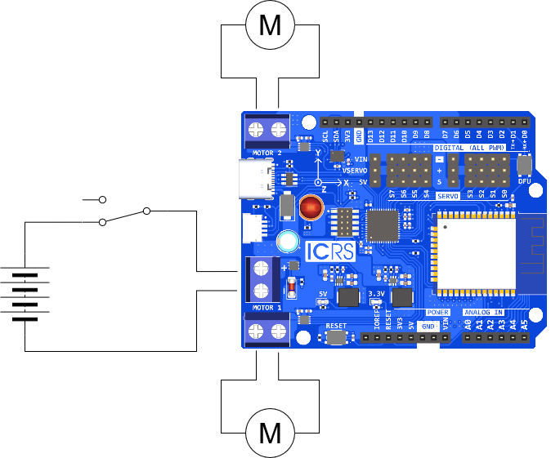
Whole robot electronics schematic

Slide 14
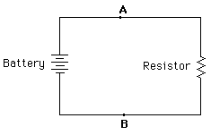
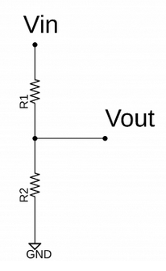
Resistors
V = IR
Current flows from high to low potentials
Uses in robotics:
Current limiting for LEDs
Pullup and pulldown resistors
Potential dividers

Slide 15
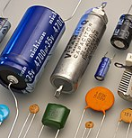
Capacitor
Stores charge
Can release a large charge in a very short amount of time

Slide 16

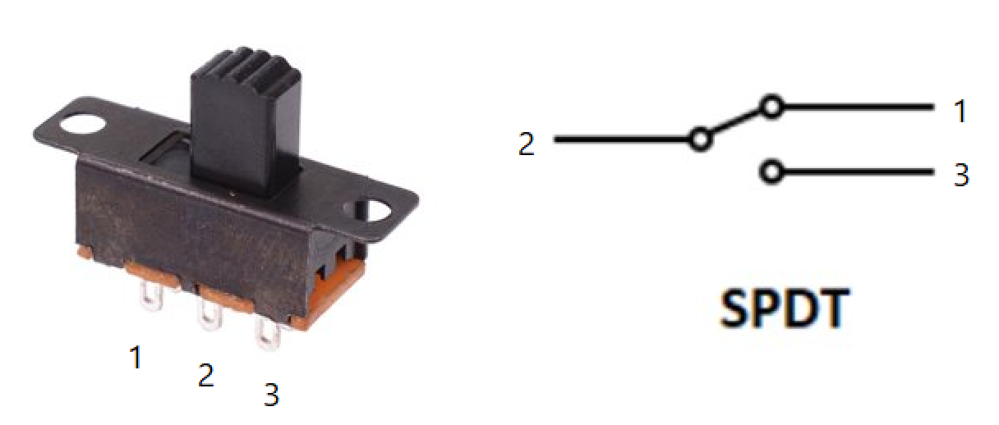
Switches & Buttons
Switch connects two contacts and completes a circuit.
This allows current to flow.
Transistors are switches that can be controlled electronically

Slide 17
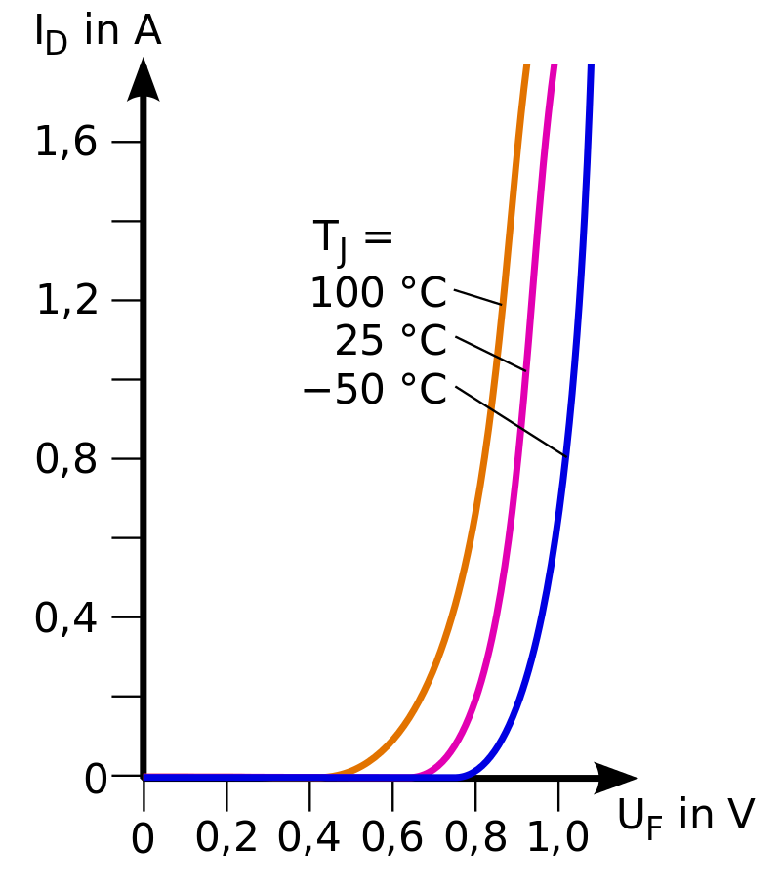
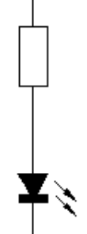
LEDs
Emit light when a voltage is put across them (in the correct orientation).
Non-linear so will explode if large voltage across them (show IV graph).
Solution is to put a resistor in series which limits the current.

Slide 18
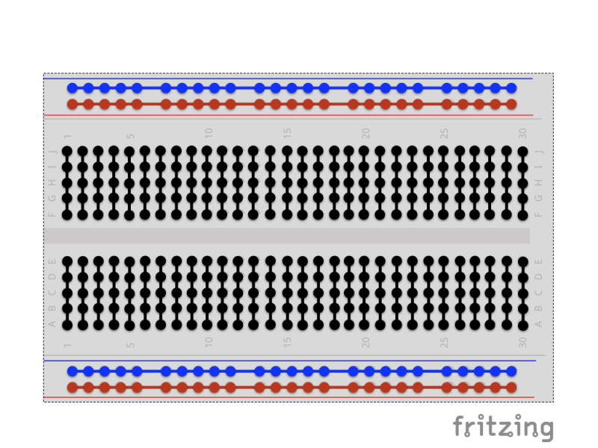
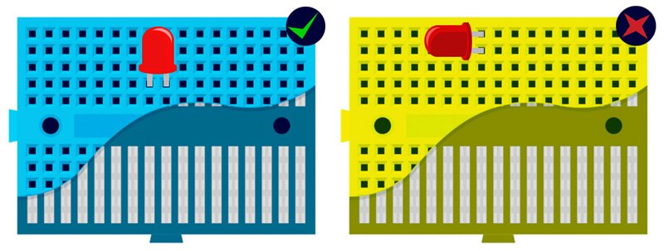
Breadboards
Holds and connects components
Used to prototype circuits with non-permanent connections

Slide 19
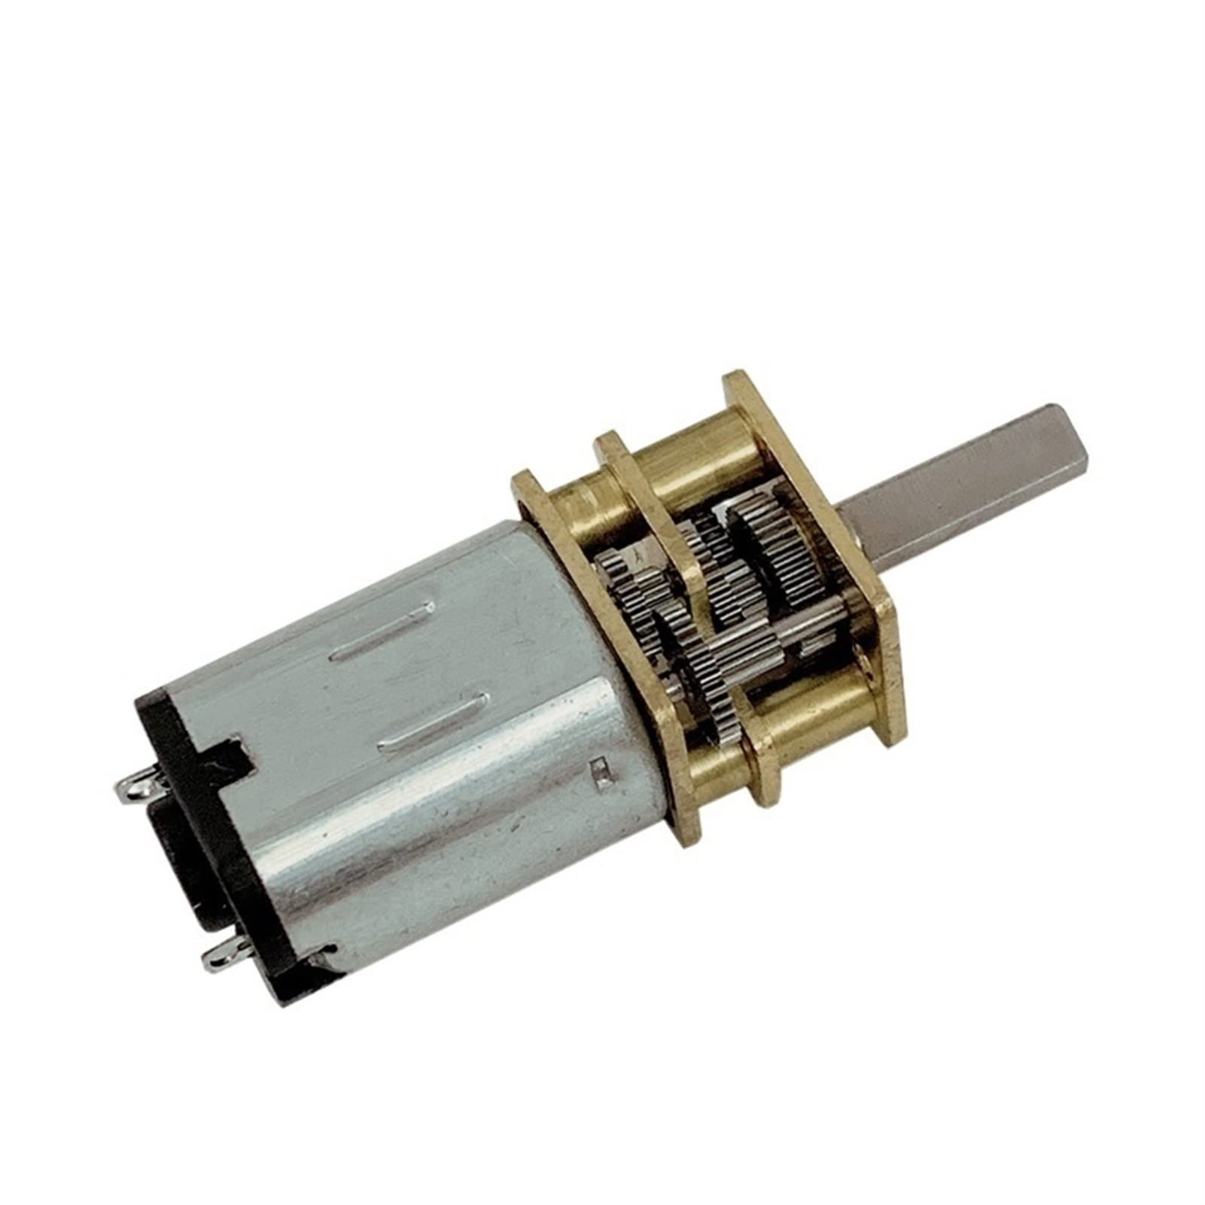
Motors
Effectively a big resistor.
Direction of current determines direction motor will spin.
Power dissipated using P = IV determines speed.

Slide 20
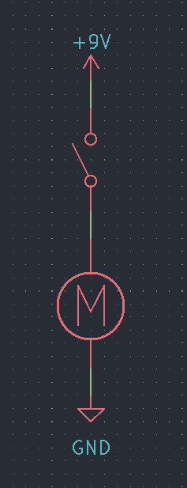
Motor Drivers - 1
Circuit with one switch: current can only flow one way so wheel can only turn one way.
Means no reversing and poor turning.

Slide 21
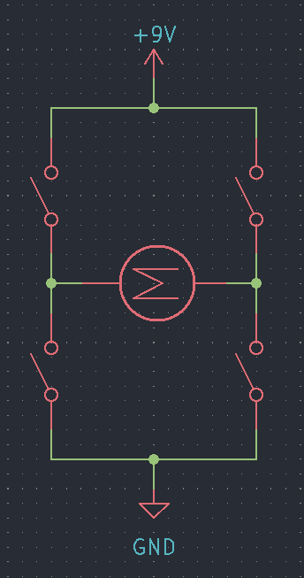
Motor Drivers – 2
H-bridge: 4 switches
Allows current to flow both ways through the motor if the right switches are closed.
Requires more control so this is typically handled by a chip.

Slide 22
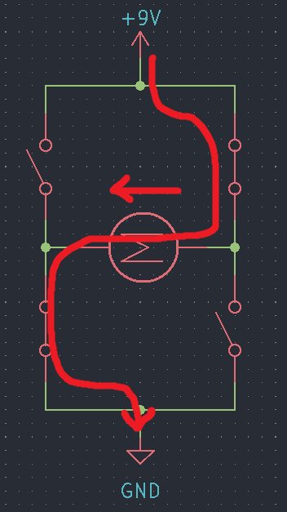
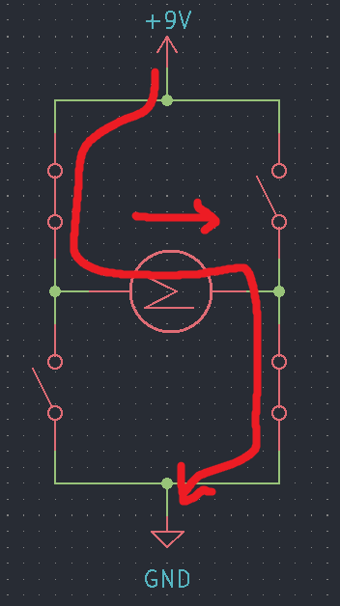

Slide 23
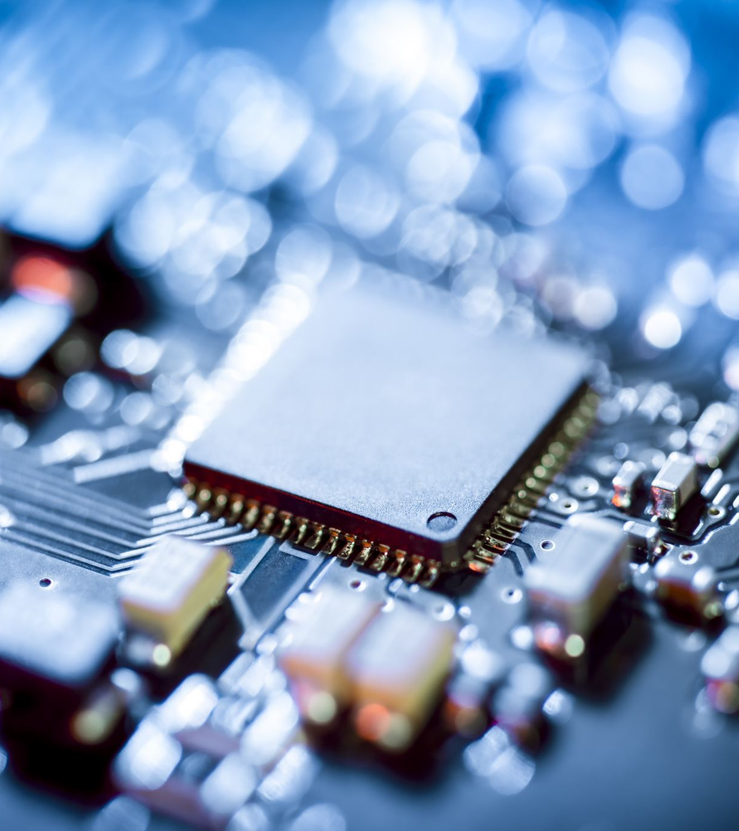
Microcontrollers
Tiny computers
Contain CPU, RAM, storage etc
Typically single or dual core
Run at tens to hundreds of megahertz
One hertz is approximately one instruction per second
Kilobytes of RAM and storage
Despite this, microcontrollers are often used with small operating systems, called real time operating systems.

Slide 24
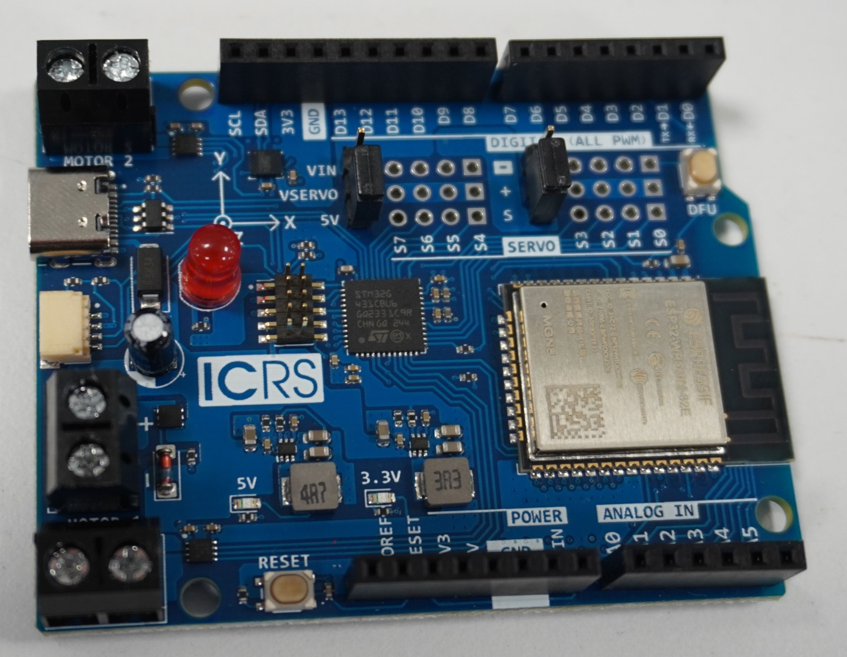
ESP32 - 1
Two 240MHz cores
4MB Flash
520KB RAM
Wi-Fi & Bluetooth

Slide 25
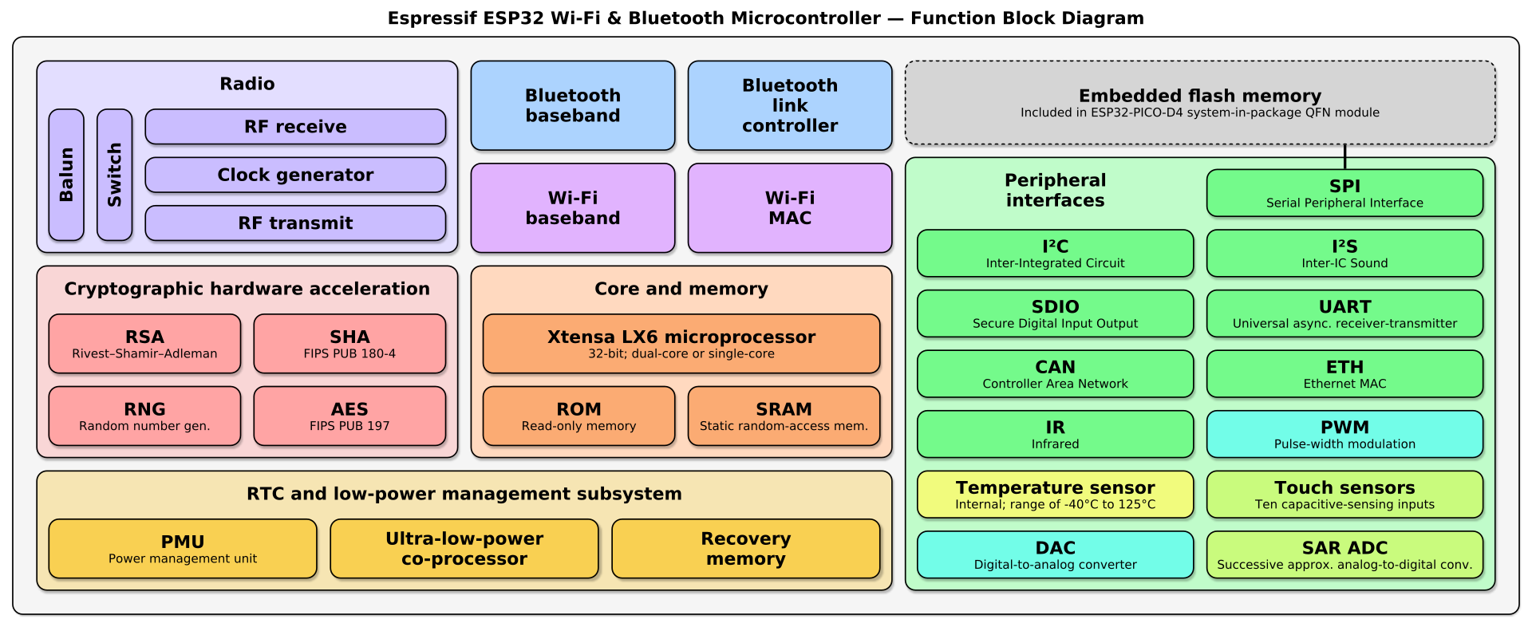
ESP32 - 2

Slide 26
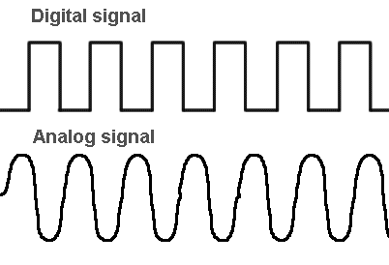
Digital IO
Digital means that there are two states: high or low which are expressed as voltages.
Typical voltages for high are 3.3V and 5V
Voltage for low is always 0V (ground)
The main way that microcontrollers interact with, and control electronics is by setting their pins to have a high or low voltage.
This can turn things on and off.
NOTE: These are logic voltages, and shouldn't be used to power anything

Slide 27
Motor Drivers – 3
Can now close switches
This allows the robot to go forwards, backwards and turn.
However, can only move at full speed.

Slide 28
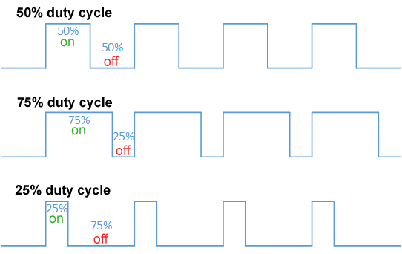
Pulse Width Modulation (PWM)
Turning on and off very fast
Duty cycle is the percentage of time the signal is high
Human eye flicker rate is 50-90Hz
However, ears can easily hear this.

Slide 29
Motor Drivers – 4
With PWM, robot can move at a variable speed
Better turning

Slide 30
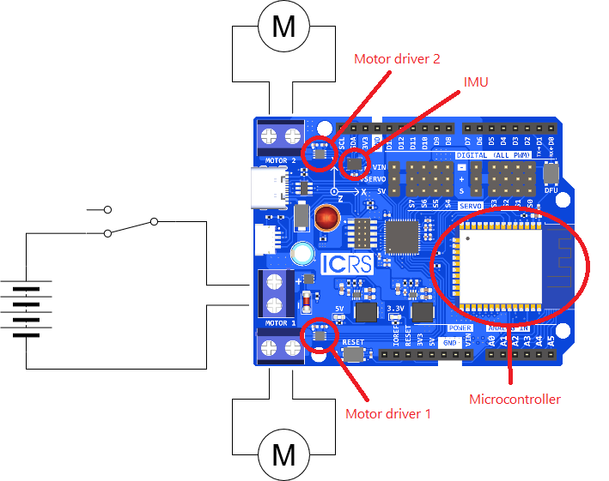

Slide 31
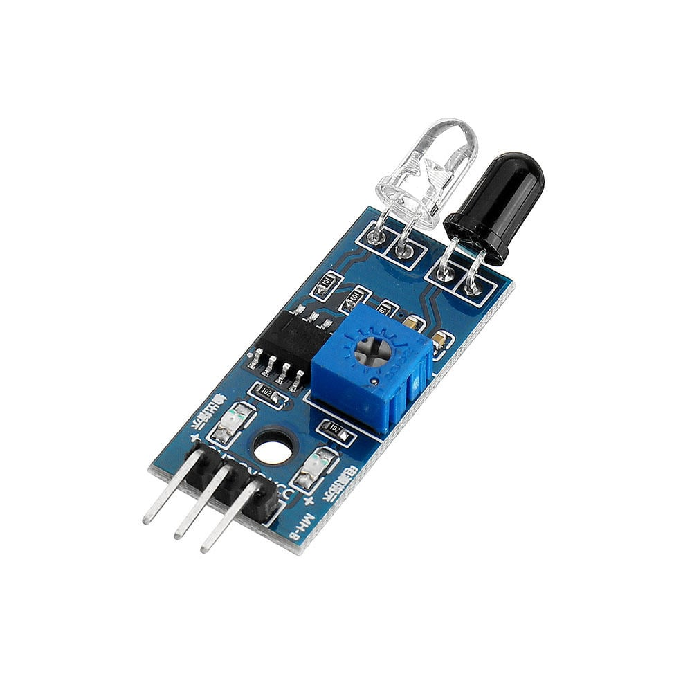
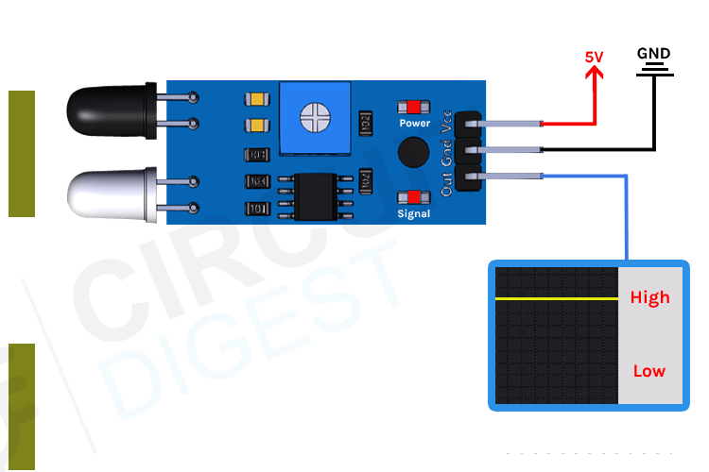
Sensors
So far, we've talked about outputting digital signals
Can also read both analogue and digital signals.
Typically from sensors:
E.g. IR Sensor, IMU

Slide 32
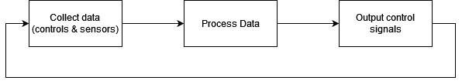

Slide 33

Questions

Slide 34


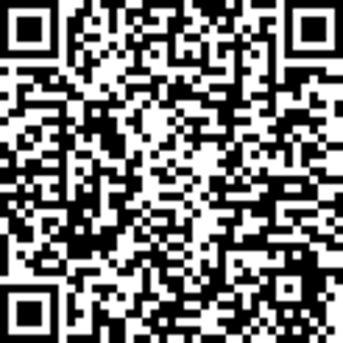
Software to download for next sessions
Fusion 360
QR code for educational licence
Arduino IDE

